Slide 1
Abstract
Brain tumor extraction and its analysis are challenging tasks in Medical image processing because brain image is complicated.
Segmentation plays a very important role in the medical image processing.
In that way MRI (magnetic resonance imaging) has become a useful medical diagnostic tool for the diagnosis of brain & other medical images.
In this project, we are presenting a segmentation method implemented for brain tumor detection.
The methods include k-means clustering for segmentation and CNN classifier for Classification

Slide 2
Introduction
The brain tumor is a massive or abnormal cell growth in a brain region. This can spread to any person among different ages.
A brain tumor can be classified into different types; these tumors can either be Malignant (cancerous) or Benign (non-cancerous).
The tumor that initially affects the brain are termed as the primary tumors whereas the tumors present in the other part of the body that might spread to the brain are known as the secondary tumors or metastatic tumors.
This project includes the method of detecting the tumor region and classifying them either normal, malignant or benign.

Slide 3
Objective
Segmentation of brain image is imperative in surgical planning and treatment planning in the field of medicine.
In this work we have proposed a computer vision approach to detect brain tumor using support vector machine which comes under machine learning algorithm to attain high accuracy.

Slide 4
Existing Methods
Fusion based : Overlapping the train image of the victim over a test image of same age group, thereby detecting the tumor.
Demerits :
•The overlapping creates complexity due to different dimensions of both images.
•Time consuming process.
Canny Based : To overcome the problem of detecting the edges, the better way is the use of Canny based edge detection.
Demerits :
•Not support color images.
•This leads to increase in time to reach the optimal solution

Slide 5
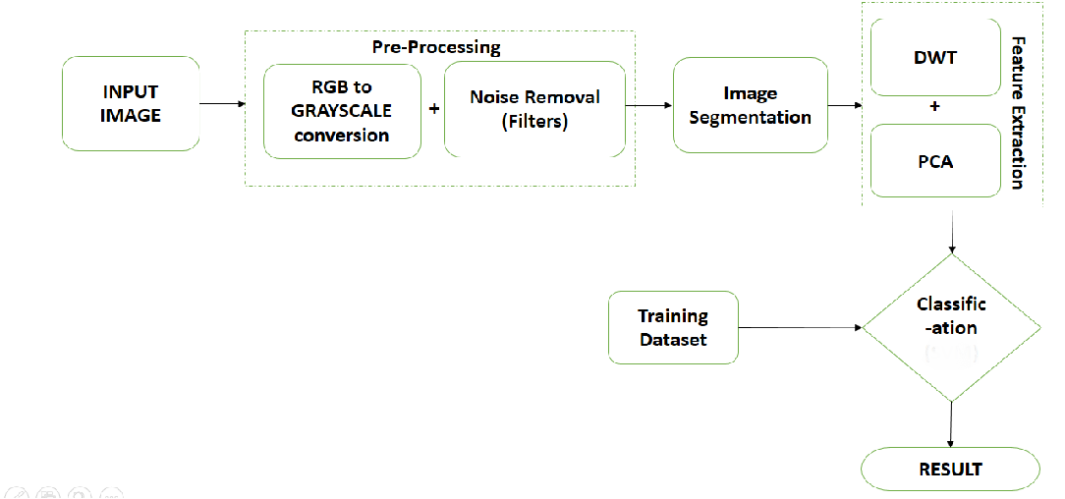
Architecture

Slide 6
Module Implementation
Pre-Processing
In this project it improve the quality of MR images and make it in a form suited for further processing.
It helps to improve certain parameters of MR image such as.
Enhancing the visual appearance of MR image .
Removing the irrelevant noise and undesired part in the background.
Smoothing the inner part of the edges.
Preserving its edges.

Slide 7
Segmentation
The preprocessed brain MR image is converted into binary image with a threshold.
The pixel values greater than the selected threshold are mapped with white, while others are mapped as black, due to this two different region will be formed around infected Tumor tissues.
The morphological operation is used for the extraction of the boundary areas of the brain image.
Rearranging the order of pixel values and it helps to process binary image.

Slide 8
Feature Extraction
Collecting higher level information such as, shape, texture, color and contrast.
Texture analysis is important to improve the accuracy of the system cohich helps to find the stages of Tumor.
Mean – It is calculated by adding all the pixel values of an image divided by the total number of pixel in an image.
Standard deviation – a higher value indicates better intensity level and high contrast of edges of an image.

Slide 9
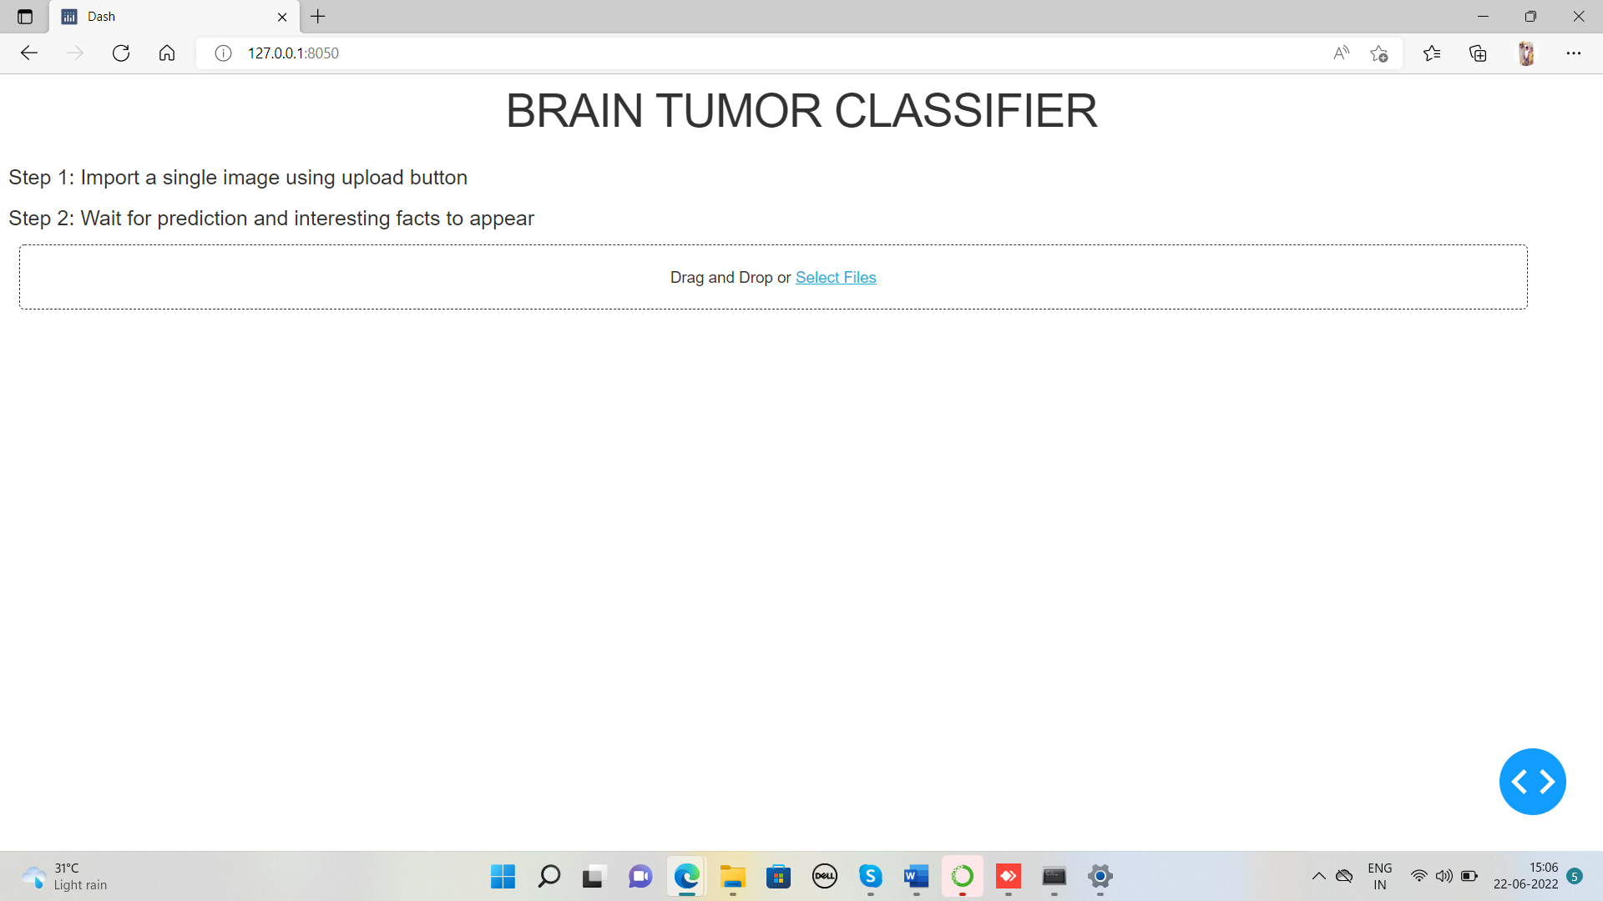
Screenshots

Slide 10
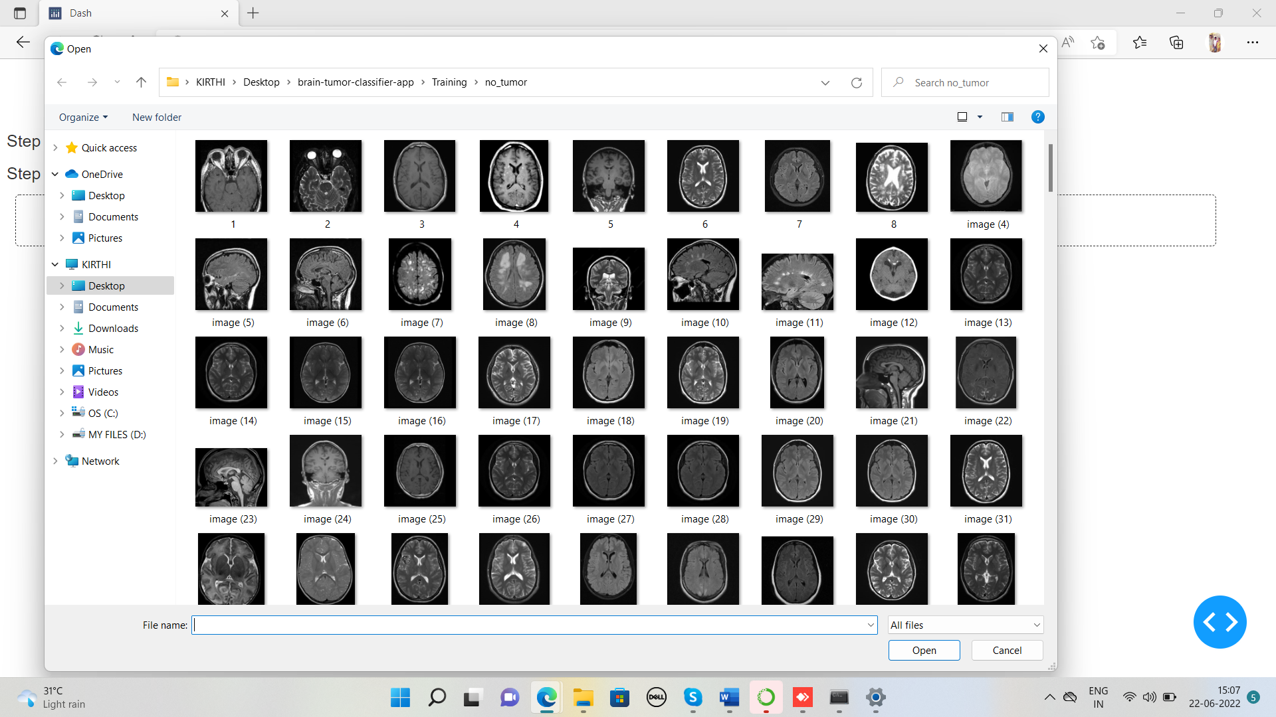

Slide 11
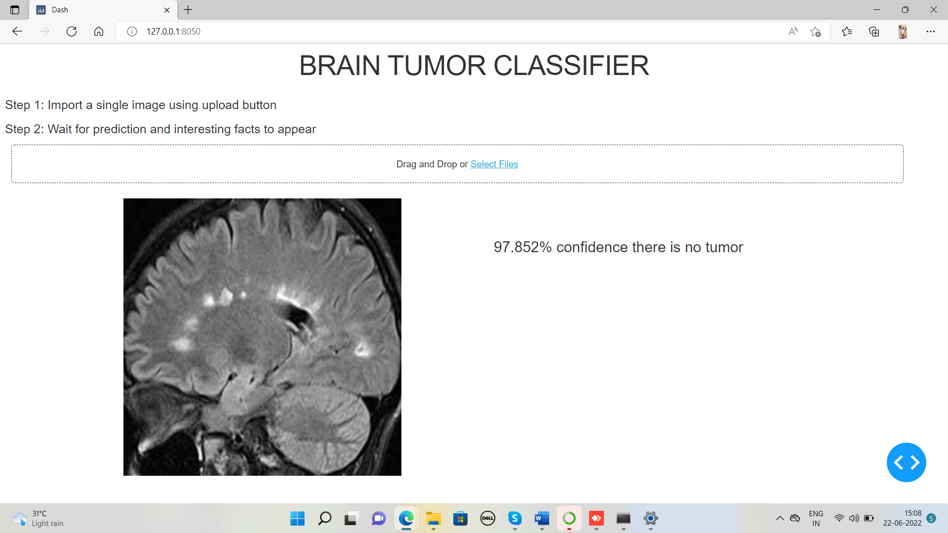

Slide 13
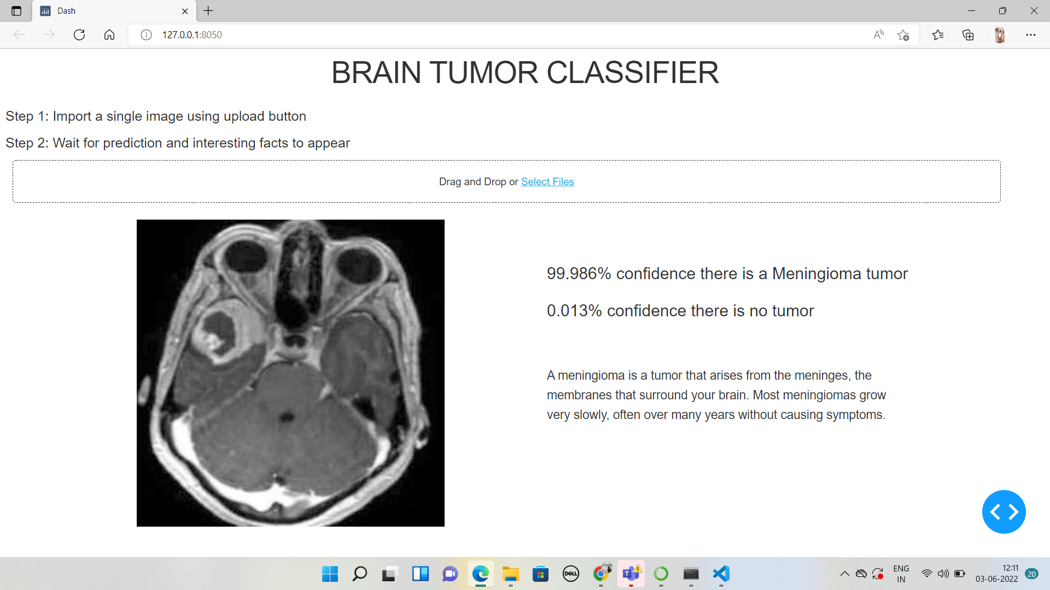

Slide 14
Result
The Proposed System is Successfully detects BRAIN TUMOR IN MRI IMAGES.
The Method include K-means clustering for segmentation and CNN classifier for classification.
The Performance of Brain Tumor using CNN is to view the Tumor clearly and to see the stages and type of Tumor.

Slide 15
Conclusion and Future Work
Algorithms for analyzing and classifying medical images have gained a great level of attention recently.
The experiments we present in this work show that after preprocessing MRI images,Support Vector Machine classiﬁcation algorithm was the best.
A much higher accuracy can be achieved by gaining a better dataset with high-resolution MRI images.
The future work may be extended this feature extraction process in terms of deep learning neural network.
Convolution neural networks are the most delicate network for the field of image processing and also the algorithm need to be extended for segmenting the tumorous area.

Slide 16
REFERENCES
1.Hasan, S. K., & Ahmad, M. (2018). Two-step verification of brain tumor segmentation using watershed-matching algorithm. Brain informatics,vol. 5(2).
2.Kilic, H., Yuzgec, U., & Karakuzu, C. (2018). A novel improved antlion optimizer algorithm and its comparative performance. Neural C.
3.Kurnar, M., Sinha, A., and Bansode, N. V. (2018). Detection of Brain Tumor in MRI Images by Applying Segmentation and Area Calculation Method Using SCILAB. In 2018 Fourth International Conference on Computing Communication Control and Automation (ICCUBEA) (pp. 1-5). IEEE.
4.Akter, L. A., and Kwon, G. R. (2018). Integration of Contourlet Transform and Canny Edge Detector for Brain Image Segmentation. In 2018 Tenth International Conference on Ubiquitous and Future Networks (ICUFN) (pp. 798-800). IEEE Jimmy
5.Astina Minz, Prof. Chanddrakant Mahobiya “MR Image classification using Adaboost for brain tumor type” in IEEE 7th International Advance Computing Conference (IACC) 2017.

Slide 17
6.Mukambika P. S., Uma Rani K. “Segmentation and Classification of MRI Brain Tumor” in International Research Journal of Engineering and Technology (IRJET) Volume: 04 Issue: 07 July -2017.
7.Rasel Ahmmed, Anirban Sen Swakshar, Md. Foisal Hossain, and Md. Abdur Rafiq “Classification of Tumors and It Stages in Brain MRI Using Support Vector Machine and Artificial Neural Network” in International Conference on Electrical, Computer and Communication Engineering (ECCE), Cox’s Bazar, Bangladesh, February 16-18, 2017 IEEE.
8.Optimization of a variational model using deep learning: An application to brain tumor segmentation, Ramírez , A. Martín , E. Schiavi, 2018
9.MR Image Classification Using Adaboost for Brain Tumor Type, Astina Minz ; Chandrakant Mahobiya, 2017
10.Md. Rezwanul Islam ; Md. Reezbhan Imteaz ; Marium-E-Jannat Detection and analysis of brain tumor from MRI by Integrated Thresholding and Morphological Process with Histogram based method”2018 International Conference on Computer, Communication, Chemical, Material and Electronic Engineering (IC4ME2)

